Slide 1
Northern Cross Energy Limited
Natural Gas Distribution System Proposal
For Servicing Huron-Kinloss, Arran-Elderslie, Kincardine and Ashfield-Colborne-Wawanosh as a Private Corporation
Utilizing the Existing Northern Cross Energy (NCE) System Assets
Natural Gas Storage Concept
Natural Gas Exploration and Production Concept

Slide 2
NCE Presentation
Overview of Northern Cross Energy (NCE).
Review of proposed Distribution System.
NCE’s storage and electrical generation concept.
NCE’s exploration and production concept.
Other Local Benefits

Slide 3
Disclaimer
All numbers contained in this presentation are Northern Cross Energy Limited’s (NCE’s) estimates only, have been developed by NCE using its resources and are provided for illustrative purposes only.
NCE does not warrant the accuracy of any of the information in this presentation.
NCE accepts no responsibility whatsoever arising in any way from any and all uses of, or reliance on, the information contained in this presentation.

Slide 4
Northern Cross Energy Limited
NCE was incorporated in Alberta in 1984 and carries on business primarily in Ontario.
It is a Canadian controlled private corporation, (CCPC)
NCE and its affiliates have produced gas in Huron County since 1988, initially exclusively to service the W.G. Thompson & Sons grain drier and later for delivery to the Union Gas system.
NCE has operated without a serious incident for more than 25 years and maintains a good reputation with regulatory authorities and the local community.

Slide 5
Northern Cross Energy Limited
The Union interconnect is now 2 way allowing delivery and receipt of gas as necessary
Ontario assets include 5 natural gas production pools, 28 miles of gathering and transmission pipelines, gas compression and processing facilities, a gas fired cogeneration facility and an operations base, all located southeast of Kincardine
Northern Cross (Yukon) Limited is an affiliated company which is active in oil and natural gas exploration in the Yukon. An Asian multinational is a major shareholder.

Slide 6
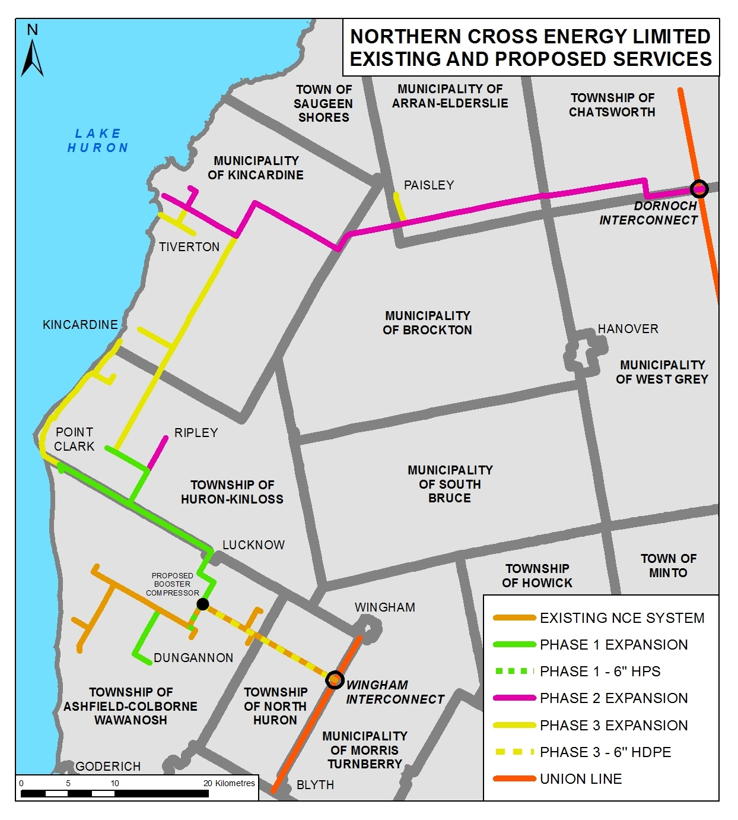
Distribution
Pipeline Routing Proposal: Wingham and Dornoch Delivery Points

Slide 7
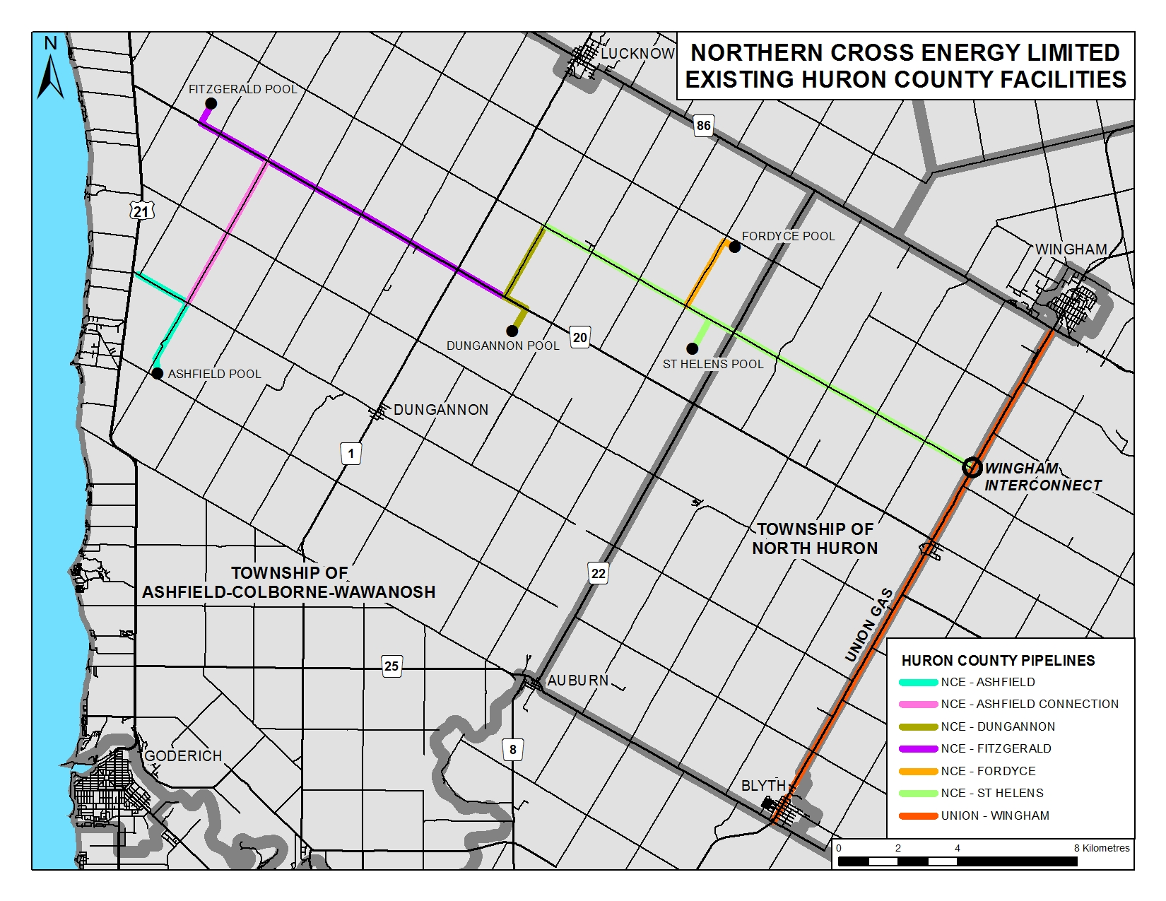

Slide 8
Pipeline System: Key Metrics
Pipeline
Storage Pool Line – 2.7 miles of 6” HP steel main with MOP of 500 psig
MDPE Plastic Distribution – 1.25” to 2” with MOP of 80 psig
HDPE Plastic Main – 15.9 miles of 4” with MOP of 180 psig
HDPE Plastic Main – 28.1 miles of 6” with MOP of 180 psig
MDPE Plastic Main (Existing NCE System) – 28.2 miles of 6” & 4” with MOP of 100 psig
HDPE Plastic Main – 71.4 miles of 8” with MOP of 180 psig

Slide 9
Pipeline System: Key Metrics
Capital Cost
All Engineering, Material, Installation, Testing and Project Management
$81,648,000
Target completion for all mains September 2017
3 Phases for mains

Slide 10
Pipeline System: Key Metrics
Gas Supply
Maximum Storage Volume from NCE – 344,600 MCF
Peak UGL Winter Deliveries: 340 MCFD from Wingham (at 100% L.F. Sept thru April) and 3,210 MCFD from Dornoch in January
Peak UGL Summer Deliveries: 3,386 MCFD from Wingham (at 100% L.F. May thru August) and 2,570 MCFD from Dornoch in May

Slide 11
Pipeline System: Key Metrics
Residential Sales
Communities of Chesley, Paisley, Tiverton, Inverhuron, Kincardine, Point Clark, Amberley, Ripley, Lucknow, Dungannon
Unit Cost - $14.12/MCF
Revenue – $5,097,900 per year
Annual Volume – 361,041 MCF
Number of Customers – 4,513

Slide 12
Pipeline System: Key Metrics
Commercial Sales
Number of Customers - 498
Unit Cost - $9.73/MCF
Grain Drying Sales
Number of Customers - 6
Revenue – $1,937,730 per year
Unit Cost - $9.73/MCF
Revenue – $627,490 per year
Annual Volume – 199,150 MCF
Annual Volume – 64,490 MCF

Slide 13
Pipeline System: Key Metrics
Industrial Sales
Number of Customers - 5
Unit Cost - $8.34/MCF
Revenue – $6,999,560 per year
Annual Volume – 839,280 MCF

Slide 14
Pipeline System: Key Lifetime Metrics
Revenue
$14,662,680 per year
Cost of Gas
$7,843,630 per year
$235,308,900 over 30 years
$439,880,400 over 30 years

Slide 15
Pipeline System: Key Lifetime Metrics
Operating and Maintenance
$2,500,000 per year
$75,000,000 over 30 years
Based on “Kincardine Group” estimate

Slide 16
Pipeline System: Key Lifetime Metrics
Ontario & Federal
Gov’t Grants
$4.5M (15% of $30 million Ontario Grant Fund)
Ontario
Gov’t Loan
2% interest rate
50 year amortization period
$948,100 annual payment
$0 annual payment
$30M (15% of Ontario fund)
$20M federal grant

Slide 17
Pipeline System: Key Lifetime Metrics
Municipal Gov’t Loan
2% interest rate
50 year amortization period
$159,120 annual payment
$5M

Slide 18
Pipeline System: Key Lifetime Metrics
Private Equity Return
10% return before tax
Private Capital Debt Service
6% interest rate
30 year amortization period
$1,305,210 annual payment
30 year investment period
$438,950 annual return
$4,389,530 initial investment
$17,558,120 loan

Slide 19
Pipeline Routing Proposal: Wingham and Dornoch Delivery Points

Slide 20
Key Total Project Metrics
The Total Project is complete in 2027 (10 years) when all of the anticipated residential and small commercial loads are forecasted to be connected
The Total Project will return 10% per year in the 10th year on
Annual Revenue | Annual Cost of Gas | Annual Equity and Debt Service Cost | Annual O&M Cost | Contribution Margin
$14,662,679 | $7,843,663 | $2,851,358 | $2,500,000 | $1,467,658

Slide 21
Competitive Fuel Analysis
Competitive Fuel Assumptions | Energy Content | Unit Price (All-in Cost)
Natural Gas | 1,010 BTU/CF | $14.12/MCF
Propane | 109,888 BTU/Gal (Cdn) | $0.60/L
#2 Heating Oil | 166,332 BTU/Gal (Cdn) | $1.37/L
Electricity | 3,413 BTU/kWh | $0.20/kWh
Fuel | $/MCF | $/m3 | $/GJ | Annual Cost *
Natural Gas | 14.12 | 0.498634 | 13.38 | $1,130
Propane | 25.07 | 0.885336 | 23.76 | $2,006
#2 Heating Oil | 37.82 | 1.335525 | 35.85 | $3,025
Electricity | 59.19 | 2.090076 | 56.10 | $4,735
* Competitive Comparison Annual Cost based on typical Residential Customer Consuming 80 MCF/Year (2,265.4 m3/y) for their space heating, water heating, laundry and cooking needs.

Slide 22
Competing Natural Gas Proposal Analysis
 | Union Gas | Northern Cross Energy
Initial Capital | $110,451,000 | $81,647,652
All-in Gas Cost (Res)
$/MCF | TBD | 14.12
$/m3 | TBD | 0.498634
$/GJ | TBD | 13.38
Aid-to-Construction | $93,757,000 | 0.00
MNGU Asset Value in 2027 | 0.00 | $81,647,652
Annual Contribution Margin | 0.00 | $1,467,682

Slide 23
What’s Next for the Distribution Project?
NCE will continue discussions with Union Gas about delivery commitments and contract parameters.
NCE will continue to refine the material, installation, engineering, permitting and project management estimates.
NCE will work with the “Kincardine Group’s” independent analysis team (BLG) to answer their Information Requests and agree on common project parameters such as the cost of gas, cost of capital, annual O&M costs and the load profiles of the various customer classes.

Slide 25
Storage Development and Electrical Generation Concept
NCE owns and operates 5 natural gas production pools located in the Township of Ashfield Colborne Wawanosh (ACW). These pools are mostly depleted but 3 (Dungannon, Ashfield and Fitzgerald) are good candidates for development as storage pools.
These 3 pools represent approximately 7,100 MMCF of working storage at a delta pressure ranging from 943 psia to 1,170 psia.
NCE’s natural gas pools are adjacent to the K2 Ontario Wind Partnership LP (K2) wind turbine project. This project includes 270 MW of wind turbine power (nameplate rating) supplied by 123 turbines. This partnership also owns and operates a 500 kV interconnect with the Hydro One transmission system (the lines that service the Bruce Power nuclear facility).

Slide 26
Storage Development and Electrical Generation Concept (cont’d)
NCE is in discussions with K2 to explore the feasibility of using the NCE storage to support a 150 MW simple cycle natural gas fuelled electrical generator.
The generator would share the 500 KV interconnect and thus make this expensive connection much better utilized.
It’s primary purpose would be to make the K2 project much more “dispatchable” from the IESO’s perspective by making this facility available during periods when the grid needs power but the wind isn’t blowing (estimated at 20 days per year).

Slide 27
Storage Development and Electrical Generation Concept (cont’d)
The major shareholder of NCE is also a major shareholder in a company that develops and manufactures utility scale hydrogen electrolyzers. This device is used to convert water to hydrogen using the electrolysis process.
This technology, in conjunction with NCE’s depleted natural gas pools, would make this facility more attractive to the OPA. It would use off-peak power from the K2 project, that is available when the wind is blowing but the grid does not need the power, to create hydrogen that can be stored and then either used to make electricity during peak power times or sold into a higher value market.

Slide 28
Pipeline Routing Proposal: Wingham and Dornoch Delivery Points

Slide 29
Local Natural Gas Exploration and Production Development Concept
NCE began as a natural gas exploration and production company. The current pools in ACW were acquired for this purpose.
NCE believes that there are likely undiscovered natural gas pools adjacent to the NPS 8 line that runs from Lucknow to Tiverton. The new pipeline would allow any new natural gas production discoveries to be easily and economically transported to market.
NCE is interested in embarking on this project if the distribution mains are constructed as shown on the pipeline map.

Slide 30
Other Local Benefits
New local high-skill, high-paying jobs to operate and maintain the new ventures.
New and lower cost fuel for existing residents and businesses and new selling feature to attract new residents and businesses.
New local natural gas storage and electrical generation development.
Ability to attach rural customers along the pipeline route.
New local natural gas exploration and production along pipeline route.

